Slide 1
Network Traffic Analysis of Ransomware Activity in the Healthcare Sector Using Wireshark and MITRE ATT&CK
K.H.S. Kodippilige, A. Nwaigwe
Department of Computer Science Minnesota State University Moorhead 1104 7th Avenue South Moorhead, MN 56563

Slide 2
Problem & Motivation
Rising ransomware in healthcare
Financial losses exceed $206 Million globally (2024)
High-value sensitive data
Need better detection methods

Slide 3
Objective of Study
Identify ransomware behavior through network traffic analysis
Use Wireshark (pcap analysis)
Map findings to MITRE ATT&CK

Slide 4
Dataset & Methodology
Analyzed packet capture (.pcap) dataset
Tools
Wireshark
MITRE ATT&CK framework
Focus
Identify Indicators of Compromise (IoCs)

Slide 5
MITRE ATT&CK Overview
Reconnaissance
Initial Access
Credential Access
Privilege Escalation
Exfiltration

Slide 6
Attack Scenario
Phishing
📧
FTP login
🔐
lateral movement 🌐
Exfiltration
📤
C2 ☁️
(Command & Control)

Slide 7
Key Findings (Wireshark Evidence)

Slide 8
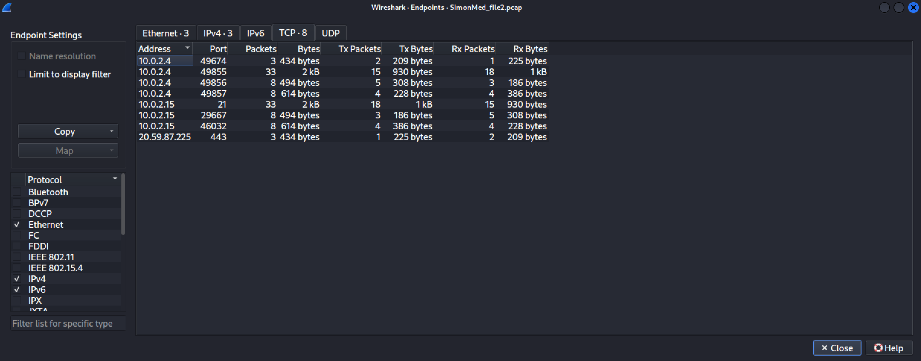
Suspicious Network Activity
Internal host → Unfamiliar external IP
(20.59.87.225)
HTTPS traffic (possible C2)

Slide 9
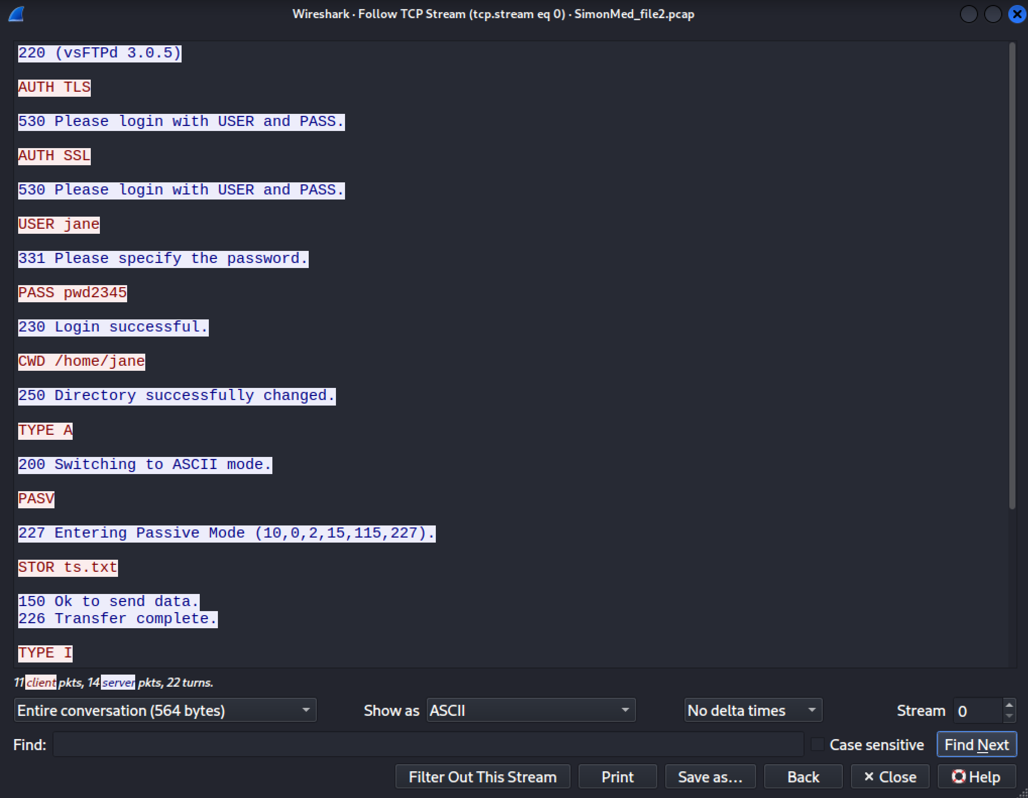
Credential Exposure
FTP login in cleartext
USER: jane
PASS: pwd2345
Confirmed login
230 success

Slide 10
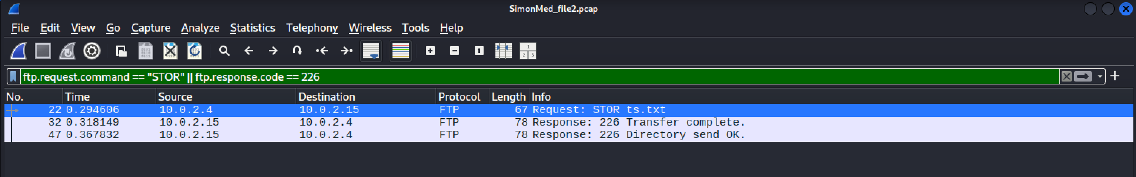
File Transfer / Exfiltration
FTP STOR = Upload command
Data transfer confirmed

Slide 11
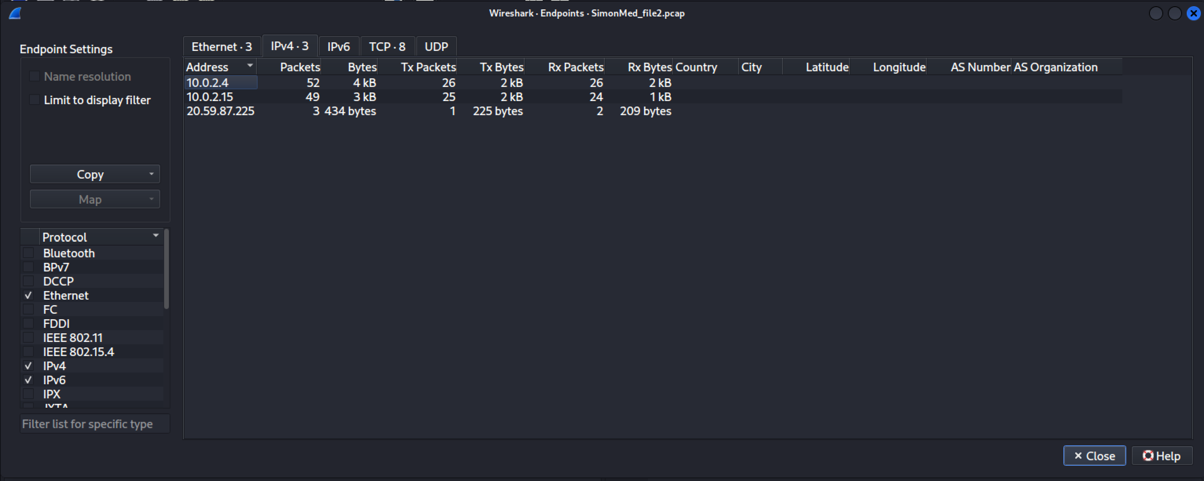
Lateral Movement
Internal spread
10.0.2.4 ↔ 10.0.2.15

Slide 12
Summary Table
Severity | Finding | Evidence | Impact
High | FTP Authentication | USER jane / PASS pwd2345 visible in TCP stream | Unauthorized access
High | FTP Login | 230 Login successful response | Gained authenticated access
High | File Transfer | STOR command + 226 Transfer complete | Data exfiltration
High | External Traffic | Connection to 20.59.87.225 via TCP 443 | Possible external relay or C2 channel
Medium | Lateral Movement | 10.0.2.4 accessing 10.0.2.15 | Lateral movement and expand
Medium | Use of FTP | Unencrypted file transfer | Credential theft

Slide 13
Key Takeaways
Network traffic provides visibility into real attacker behavior
MITRE ATT&CK helps structure analysis
Weak protocols like FTP is a major risk

Slide 14
Conclusion
Ransomware follows identifiable patterns
Wireshark can expose critical IoCs
MITRE ATT&CK improves structured analysis
Healthcare networks need stronger monitoring

Slide 15
Future Work
Automate IoC detection
Improve monitoring (especially insecure protocols)

Slide 16
References
Sanders, C. (2017). Practical packet analysis (3rd ed.).
Easttom, C. (2023). Computer Security Fundamentals
(5th ed.). Pearson Education.
Center For Strategic and International Studies (CSIS). Significant Cyber Incidents. https://www.csis.org/programs/strategic-technologies-program/significant-cyber-incidents
MITRE ATT&CK. https://attack.mitre.org/

Slide 17
Q&A

Slide 18

EVALUATE THIS PRESENTATION
Presentation ID: 10060
Scan the QR code to evaluate the presentation, or visit: https://bit.ly/sac2026-eval

Slide 19
Thank you!

